Slide 1

Project 2 Presentation:
To Churn or Not to Churn
OPIM 5604 - B12: Predictive Modeling
Team 2: Meghna Ashok, Luke D’Agostino,
Mohit Khanna, Logan Miller, Stuti Viyulie
Notes:
Mohit

Slide 2

Telco Customer Churn Dataset Overview
Dataset
7,043 rows
21 columns
19 predictor variables
17 categorical
2 continuous
1 unique identifier
1 target variable
Target Variable
Churn - Yes or No
Class of interest: Yes
Business Value
Understand customer retention
Identify customer departure drivers
Notes:
Mohit

Slide 3
The Business Problem
California-based Telco wants to understand the drivers behind their increased customer churn rate
We will build predictive models to help the Telco validate or reject the following:
Millennials churn faster?
Churn rate higher for a particular product?
Multiple Lines leads to increased churn?
Subscriptions to additional VAS leads to increased churn?
Subscriptions to device protection plans reduces churn?
Increasing # of Dependants reduces churn?
Upselling TV and movie streaming plans reduce churn?
Notes:
Mohit

Slide 4
Data Pre-Processing & Methodology
SEMMA Process
Sample, Explore, Modify, Model, Assess
Partition of 60:20:20 (Training/Validation/Test)
Categorical variables to Dummy variables using Indicator columns.
‘TotalCharges’ column had 11 missing values.
No Outliers. Among continuous variables.
No need of Standardization or Principal Component Analysis.
Notes:
Meghna

Slide 5
Exploration of Data
Senior Citizens | More likely to churn than middle aged customers.
Customers without partners | More likely to churn as compared to customers with partners.
Customers without dependents | More likely to churn as compared to customers with dependents.
Customers with phone service | More likely to churn as compared to customers without phone service
Customers with Multiple lines | Slightly higher churn rate, compared to customers who have taken up a single service.
FiberOptic Internet service | More likely to churn than customers who have taken DSL
Notes:
Meghna

Slide 6
Exploration of Data
Month to Month contract | Higher chance of churning than other contract types
Paperless Billing participants | More likely to churn as compared to customers with in-mail billing
Electronic Check payment method | More likely to churn as compared to customers with other payment plans
Customers with the 4 add-on services (Online security, Online backup, Device protection and Tech support) | Less likely to churn as compared to customers without these services
Newer Customers (Tenure < 15 months) | More likely to churn than those with higher tenure
Streaming TV & Streaming Movies | Little to no effect on churn rate
Notes:
Logan

Slide 7
The Modeling Process
Goal: develop a reliable forecasting model to predict the categorical target variable of churn (Yes or No)
Built every model possible for this type of target using all predictor variables
Used variable selection results from the logistic regression model to create a second group of predictors
Used this subset to re-create every one of the models again, only with significant variables
This resulted in 2 groups of models:
Group 1: All Predictor Variables
Group 2: Only the Significant Variables (as determined by the logistic regression model)
Notes:
Logan

Slide 8
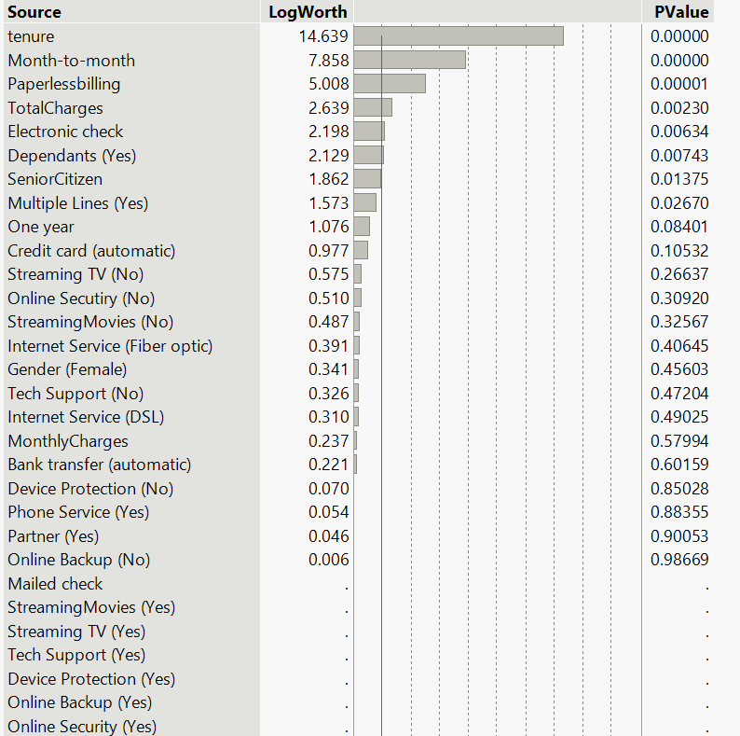
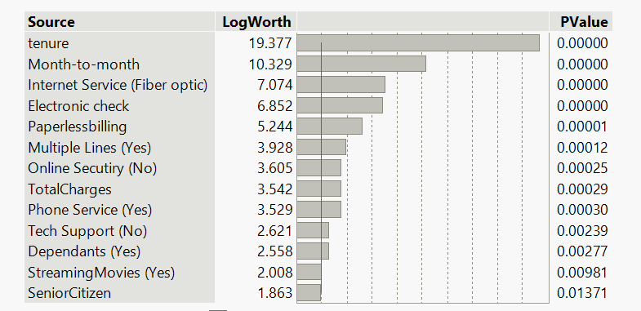
Logistic Regression - Variable Selection
Group 2
Group 1
Notes:
Logan

Slide 9
Model Assessment - Group 1 (All Predictor Variables)
Notes:
Luke

Slide 10
Model Assessment - Group 1 (All Predictor Variables)
Notes:
Luke

Slide 11
Model Assessment - Group 2 (Significant Variables)
Notes:
Luke

Slide 12
Model Assessment - Group 2 (Significant Variables)
Notes:
Luke

Slide 13
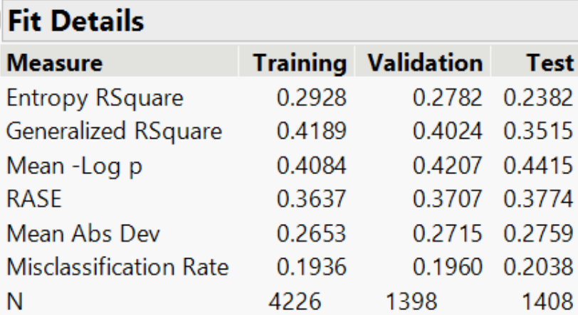
The Best Model
Group 1 - All Predictor Variables
Group 2 - Significant Variables
Nominal Logistic Model
Other top performing models
Overfit → growth rate
(validation MR - training MR)/(training MR)
Notes:
Stuti

Slide 14
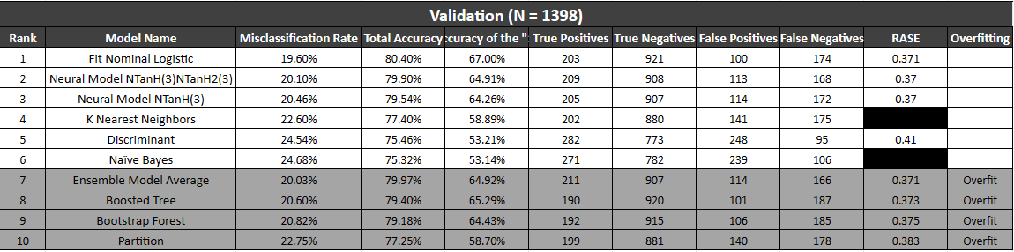
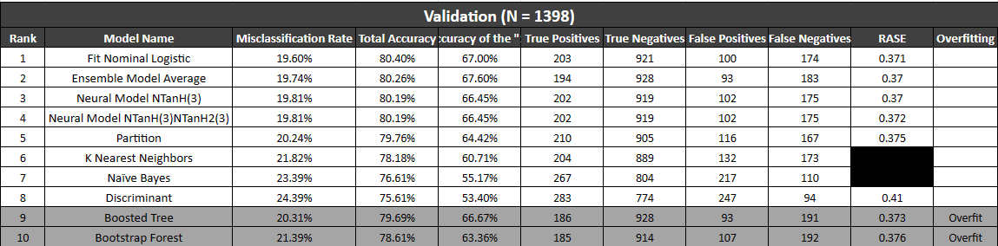

GROUP 1:
GROUP 2:
Notes:
Stuti

Slide 15
Business Recommendations
The modeling efforts have led to the following recommendations:
Focus on at risk demographics
Improve customer service experiences
Push year-long contracts rather than month-to-month
Offer discounts and additional services (i.e. Tech Support)
Notes:
Stuti

Slide 16
Thank You!

Slide 17
Appendix

Slide 18
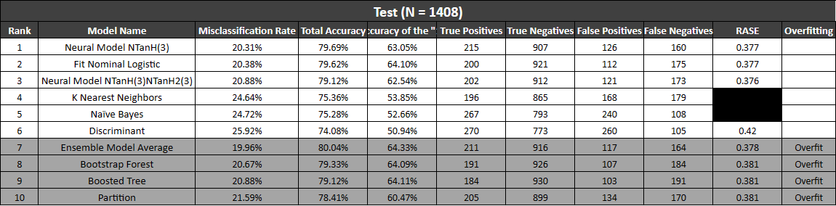
Model Assessment - Group 1 (All Predictor Variables)

Slide 19
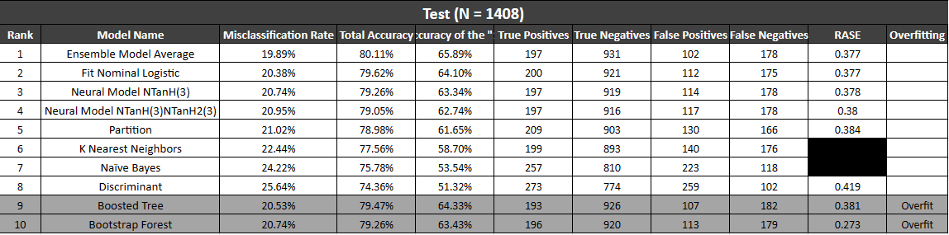
Model Assessment - Group 2 (Significant Variables)

